Slide 1
APSG
BIM Integrations for Operations
APSG 43 Spring Meeting
THE IMPACT OF AUTOMATION
ON THE GEODETIC WORKFLOW

Slide 2
Summary:
The use of hyperspectral sensors to help enhance the digital twin environment adds additional lifecycle features that enable more efficient condition monitoring. An overview of a coordinated Building Information Modeling (BIM) service supporting the digital lifecycle of 3D/2D model integrations will be discussed to support the Hololens and the delivery of "model load packages", which allows the user to view the various models required to integrate with Hololens features. Detailed asset views converted from static drawings enable a full 3D view of the individual components. The use of embedded sensor data is used to augment the BIM model which supports its use in Digital Twin projects.

Slide 3
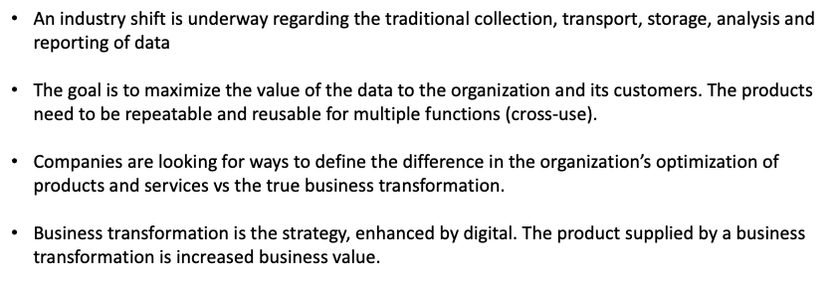
BIM Integrations for Operations

Slide 4
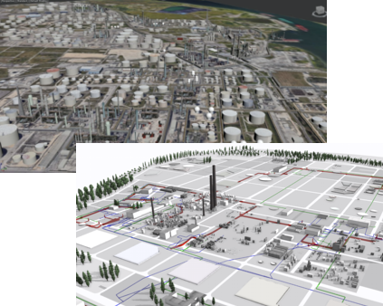
BIM Integrations for Operations
Three primary terms whose definition needs clarity due to the various uses in business:
digitization,
digitalization
digital transformation.
The concept of BIM is provided to define the value to an organization looking to implement this data-intensive program.

Slide 5
BIM Integrations for Operations
Digitization (business optimization - run)
The conversion of analog or physical information to a digital format.
Reports and drawings are typically generated and delivered via paper (analog) with no direct access to the metadata. The use of digitization is a key driver for BIM (building information modeling) revolution occurring in what is now considered the 4th industrial revolution. Video is another example where traditional media was stored on disk, CD’s, and tapes without relevant metadata available to report on (just visual inspection data).
Digitalization (business growth-grow)
The use of digital technologies and digitally-enabled approaches to enable or improve business models and processes.
The use of remote tablets to capture inspection data in real-time and the use of streaming video to provide live infield data are key examples of digitalization. The addition of sensors to monitor the health of an asset is a component of enabling a digital twin concept, which is enabled with historical, real-time and forecast data.
Digital transformation (business transformation - transform)
The coordinated digitalization change efforts at scale, integrated through the operating model and all aspects of the business, including people, processes, technologies, and metrics (kpi’s).
The goal is to bring meaningful outcomes to the organization. The integration of BIM lifecycle management and digital twins for all assets is one way of doing business process transformation using digital tools.

Slide 6
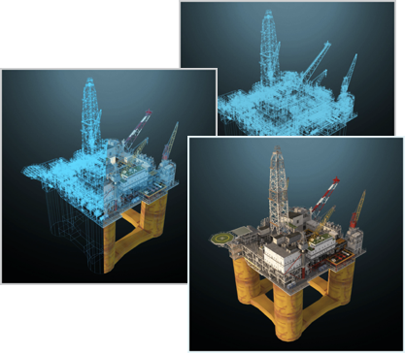
BIM Integrations for Operations
Organizations are beginning to productize the use of digital twins to help improve efficiencies through the use of augmented reality solutions.
The core product use is an interactive representation of a geographic area and all its installations. Users can go anywhere and see everything as they would in real life with the added benefit of a complete overview, fit for purpose viewing and one-click access to related documentation.
The intent is to use this “digital twin” aspect to assist the operations team to perform risk-based assessments, spare parts analysis, and virtual warehousing

Slide 7
BIM Adoption
A BIM implementation must be supported fully by the business
It shouldn’t be just an R&D, IT or pilot project

Slide 8
BIM Data Flow
“A basic premise of BIM is collaboration by different stakeholders at different phases of the life cycle of a facility to insert, extract, update or modify information in the BIM process to support and reflect the roles of that stakeholder. The BIM is a shared digital representation founded on open standards for interoperability.”
United States National BIM Standard V1, P1 Jan 2008

Slide 9
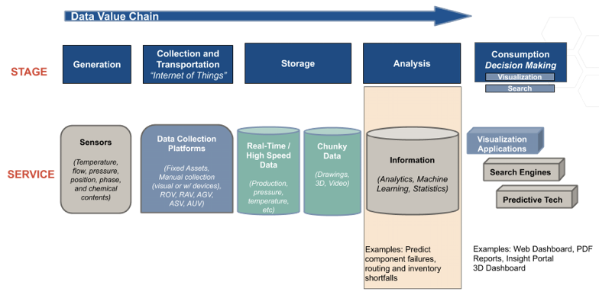
BIM DATA VALUE CHAIN

Slide 10
BIM – Adopt Best Practices, Standards, & Guidelines
US National BIM Standard
https://www.nationalbimstandard.org/
EMEA UK-Bsi Standard Framework and Guide to BS1192
Netherlands-Rgd BIM
APAC Singapore-BIM Guide Version 2

Slide 11
BIM VALUE PROPOSITION

Slide 12
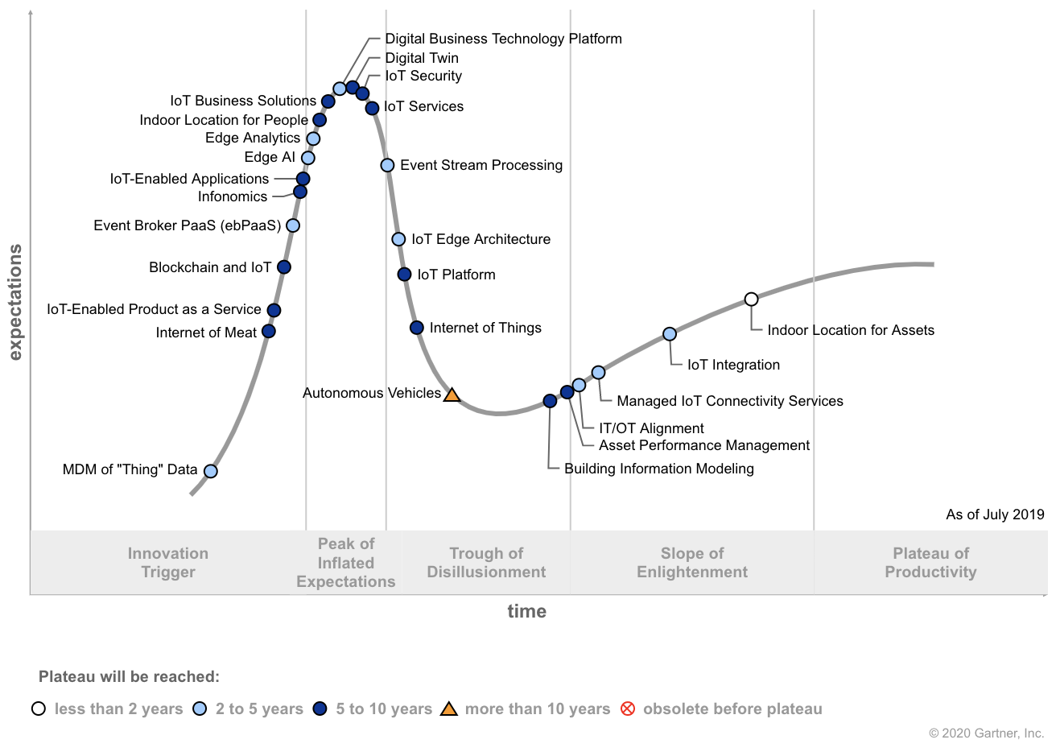
Internet of Things Hype Cycle

Slide 13
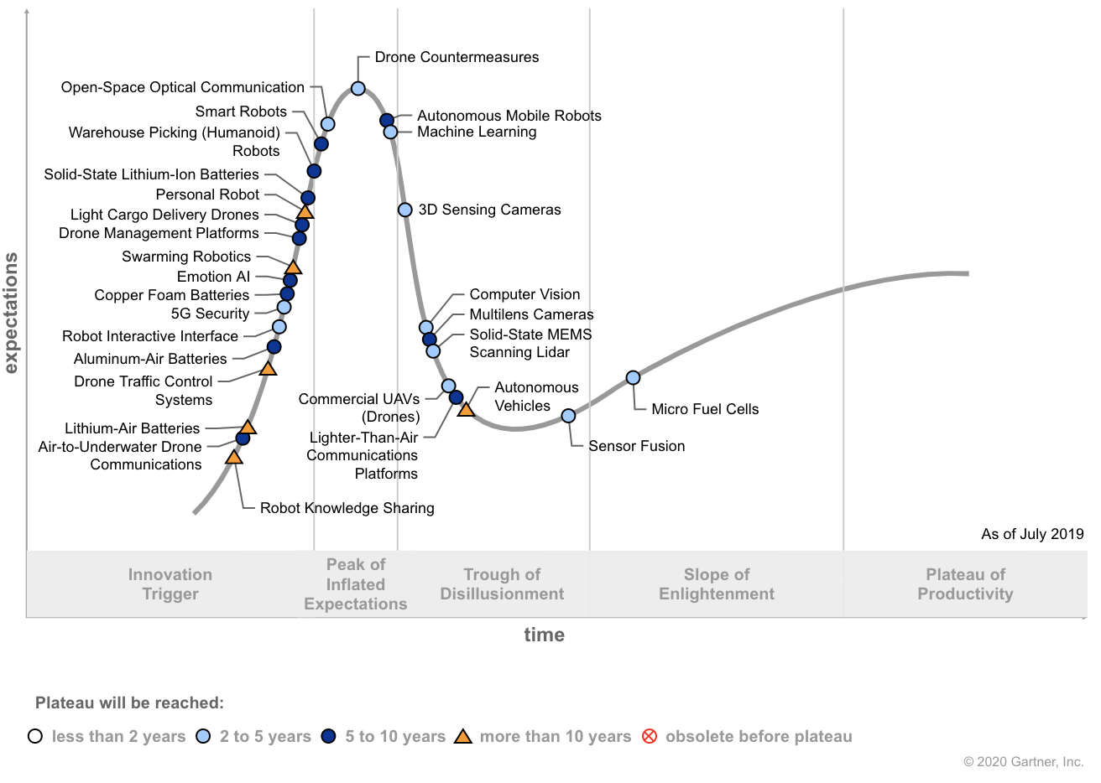
Mobile Robotics Hype Cycle

Slide 14
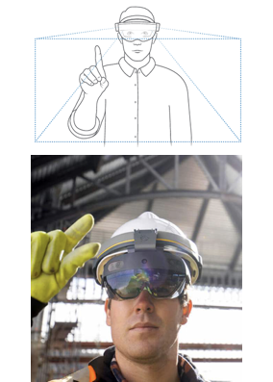
Mixed Reality Sensors
The use of mixed reality solutions to help enhance the digital twin environment adds lifecycle features that enable more efficient condition monitoring. The BIM process ensures the model data is available for the various use cases
The combined use of augmented inspection reporting and corrective maintenance instructions allows for a streamlined inspection approach through the use of portable and in situ sensors and mobile inspection campaigns

Slide 15
Mobile Disruption
The integration of enhanced cameras, sensors and integrated software solutions are laying the ground- work for additional 3D and Geospatial Assets

Slide 16
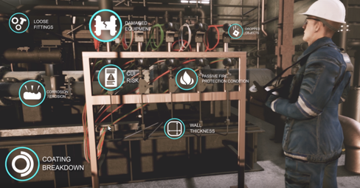
BIM Integrations for Operations
OPERATIONS ASSESSMENT
The integration of an assets operating data, both historical and real-time, can provide input into the overall integrity management program and allows for more accurate assessments to occur. This can include fluid flows and pressures experienced by the asset over time and mechanical adjustments such as valve turns and gate activations.

Slide 17
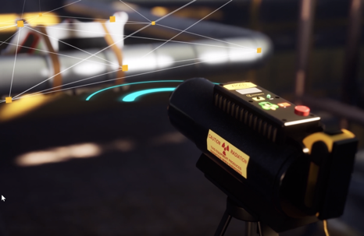
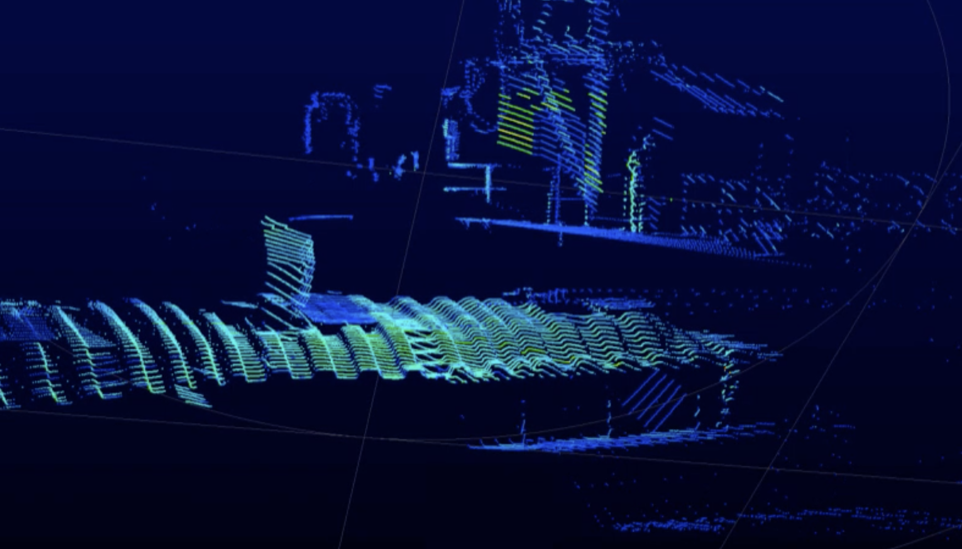
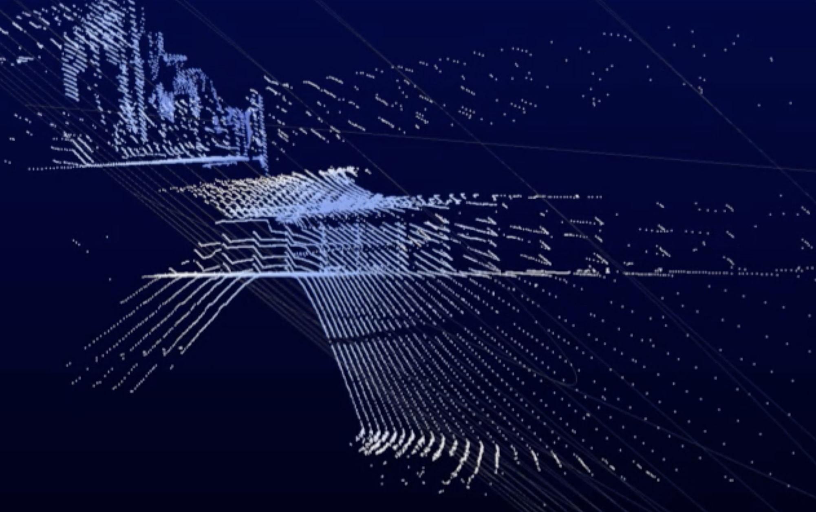
BIM Integrations for Operations
SENSOR INTEGRATIONS
The use of sensors to collect data has traditionally involved temporary installations with personnel bringing the sensors or mounting them in the area to be inspected.
Connectivity options today involving wired and wireless installations allow for a distributed approach where the sensors can be left in-situ to allow for longer term data collection.

Slide 18
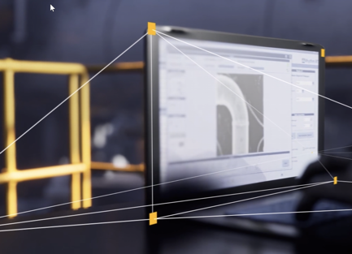
BIM Integrations for Operations
SENSOR PORTABILITY AND WEARABLES
The dominant growth of laptops for field work has evolved towards newer data capture methods using tablets and sensor integrated portable hardware (sensor specific).
The available options for connectivity for the mobile devices also allows the real-time transmittal of information captured by the device.
The integration of spatial features built into the devices has enabled the location-based data which provides an additional depth to the inspection campaign. With one photo capture, one can capture the imagery, the temperature (hyperspectral), the 3d-facing profile, and the location where the image was captured.

Slide 19
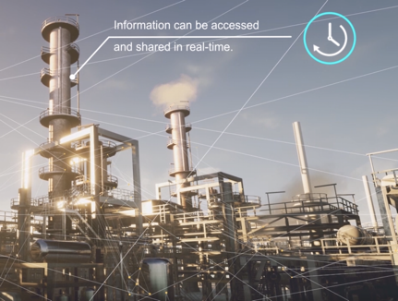
BIM Integrations for Operations
RESULTS AND DISCUSSION
There will continue to be a need for human curation and validation when it comes to final signoff and approval for integrity information interpretation, but the vast majority of data collection can be done by sensors and machines.
The key is how a company’s inspection strategy views the cost of collection and overall data value.
The goal is to maximize the value of the data to the organization and its customers.

Slide 20
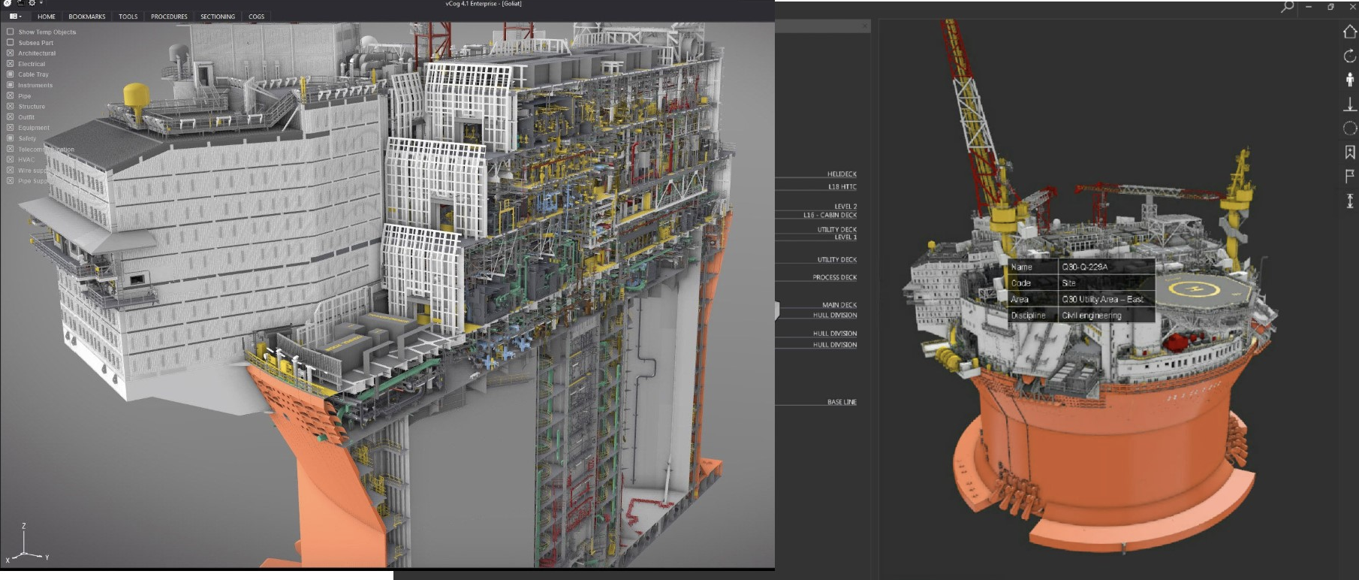
BIM Integrations for Operations
SCALE
The scale of assets in the BIM world requires newer technologies to stream large data sets. This enables lower CPU powered hardware to manage large, complex structures remotely

