Slide 1
Automated infill optimization for a marine 3D seismic survey
Dave Ridyard and Damian Hite

Slide 2
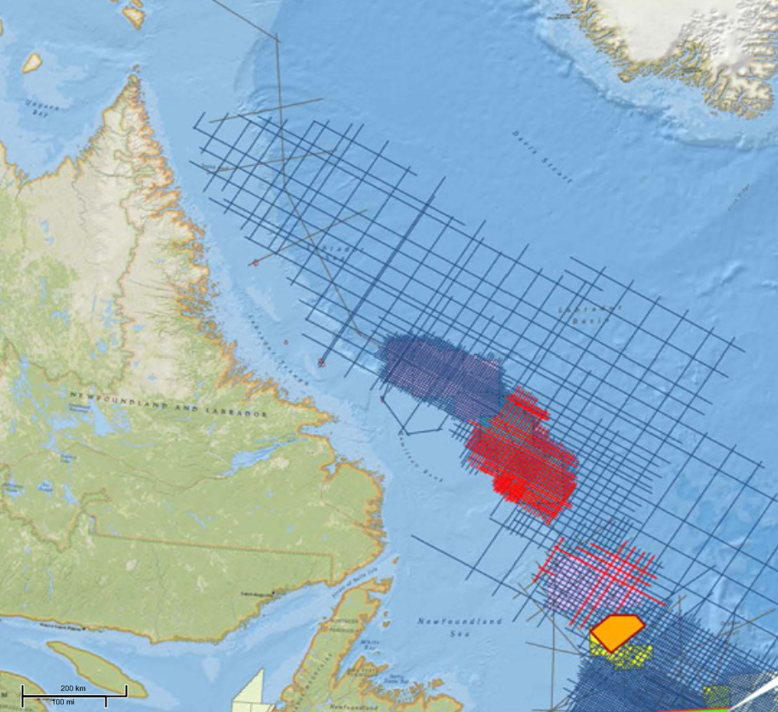
Presentation Outline
2D / 3D Project description and challenges
Estimating infill
Reducing infill
Final thoughts

Slide 3
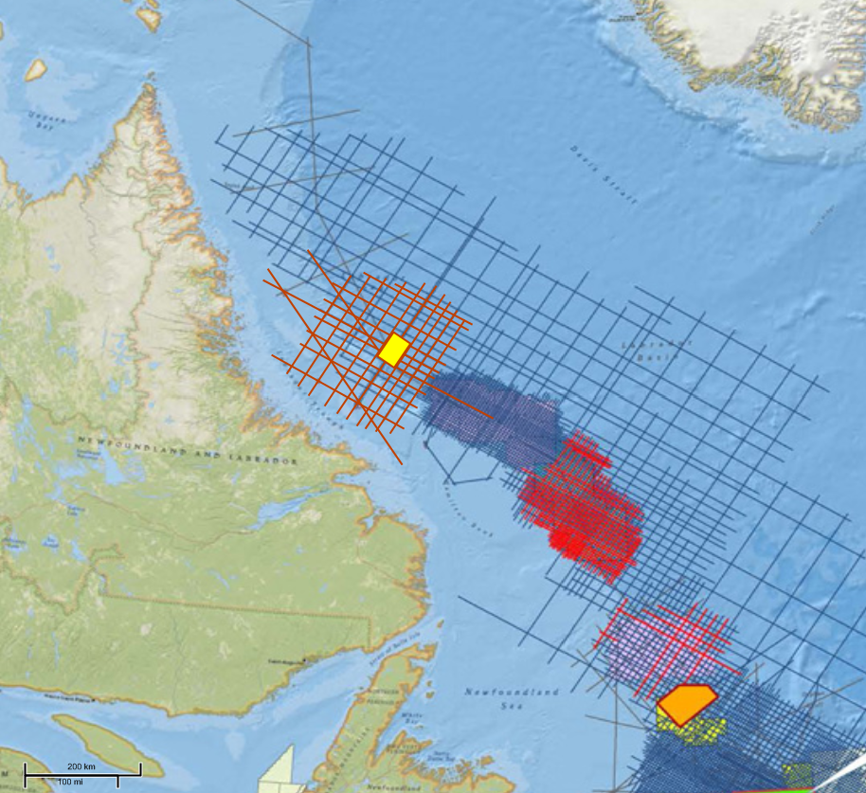
Project Description Overview
Unobstructed frontier area
Offshore Labrador, Canada
1,700 sq.km. 3D
Regional 2D program

Slide 4
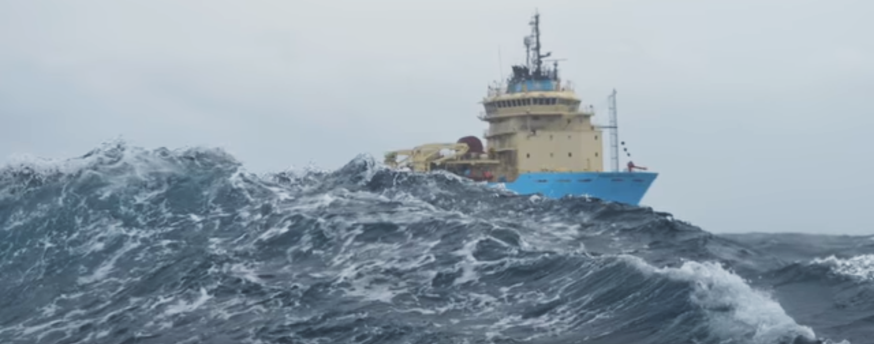
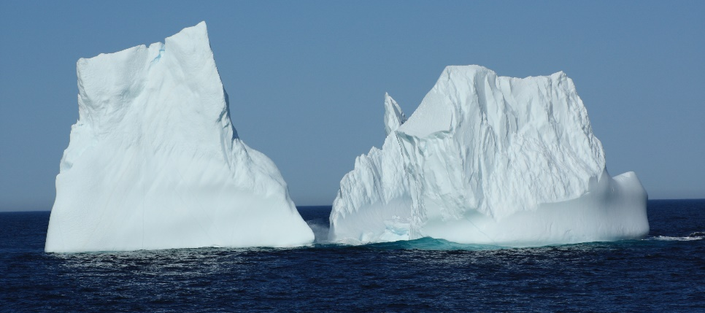
Project Description Challenges
Short acquisition season : 60-90 days
Currents around shelf slope
Infill uncertainty

Slide 5
2D Design
5,591.3 km
10km streamer
Est. 35.6 Days (+Mobilization)
Environmental impact
Shots 223,652
Area of insonification 104,118.2 sq.km.
Area of operations 117,985.8 sq.km.

Slide 6
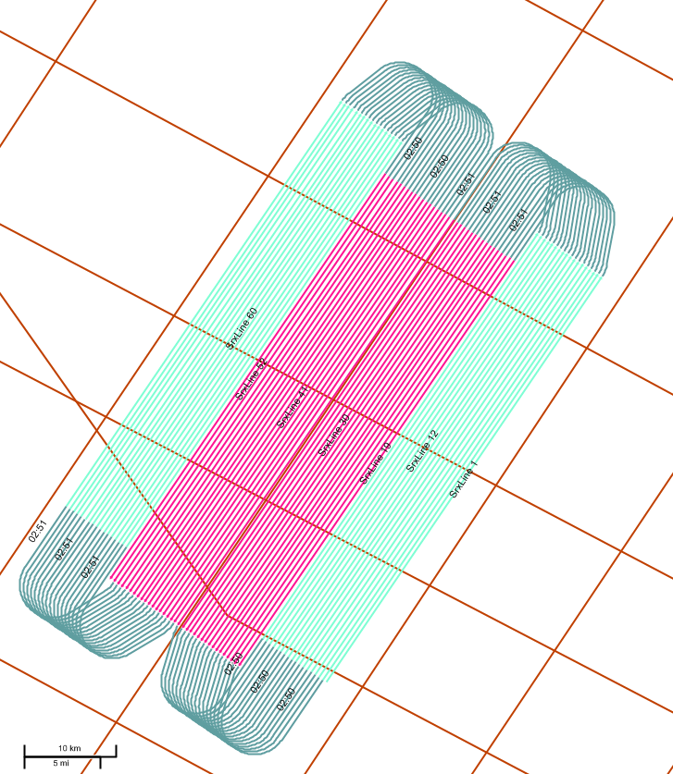
3D Design
Baseline design
5 sources
10 streamers
2 racetracks (AB-BA)
3,780 Line km (including run outs)
Downtime model
15% weather standby
5% technical downtime
Approx 30.3 days vessel time
Environmental impact
302,365 shots
Area of insonification 2,296 sq.km.
Area of operations 2,925 sq.km.

Slide 7
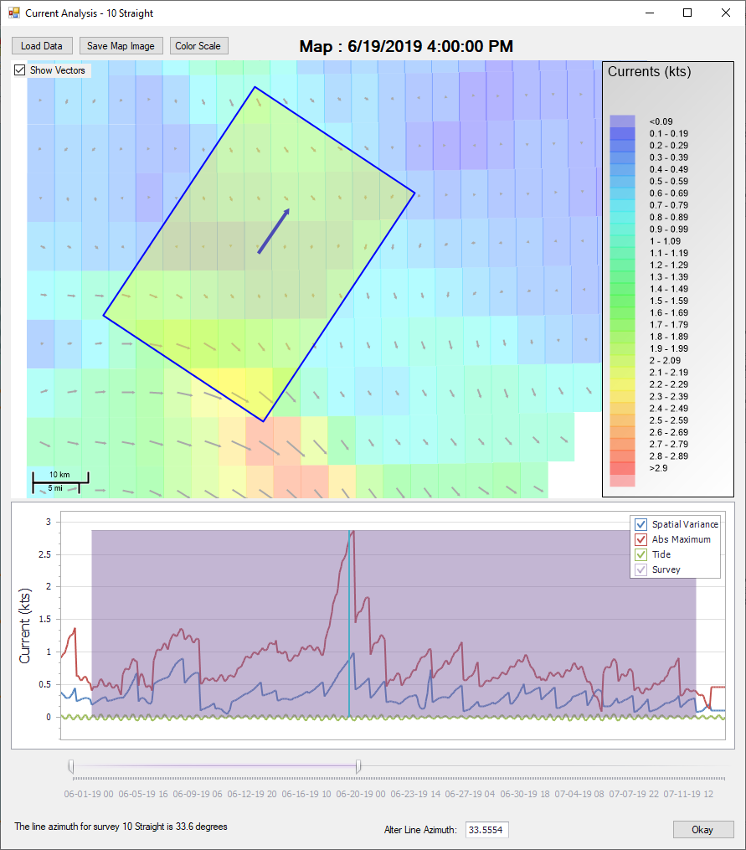
Infill estimation
Temporal and spatial current variation
Ocean currents
Tidal currents

Slide 8
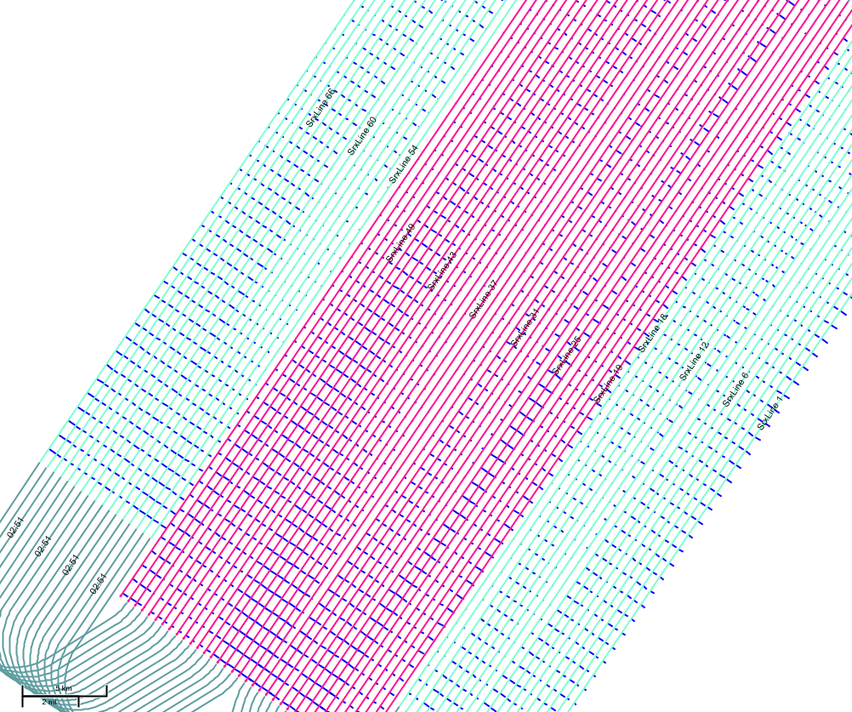
Current model applied to Survey Design Based on actual survey timing
Inline and crossline current vectors computed for every shot.
(Only crossline component shown.)

Slide 9
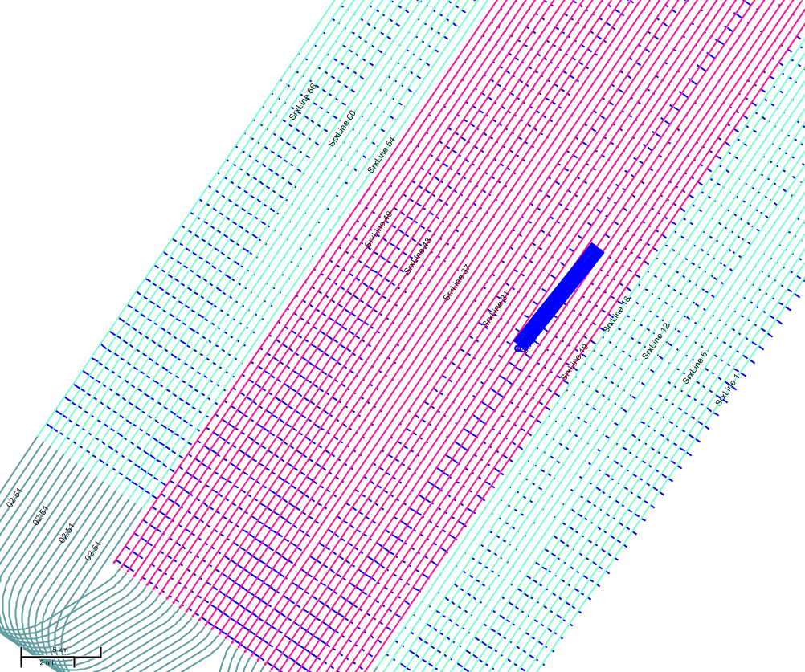
Current model applied to Survey Design Based on actual survey timing
Mismatched feathering on adjacent lines results in missing coverage
Infill lines required

Slide 10
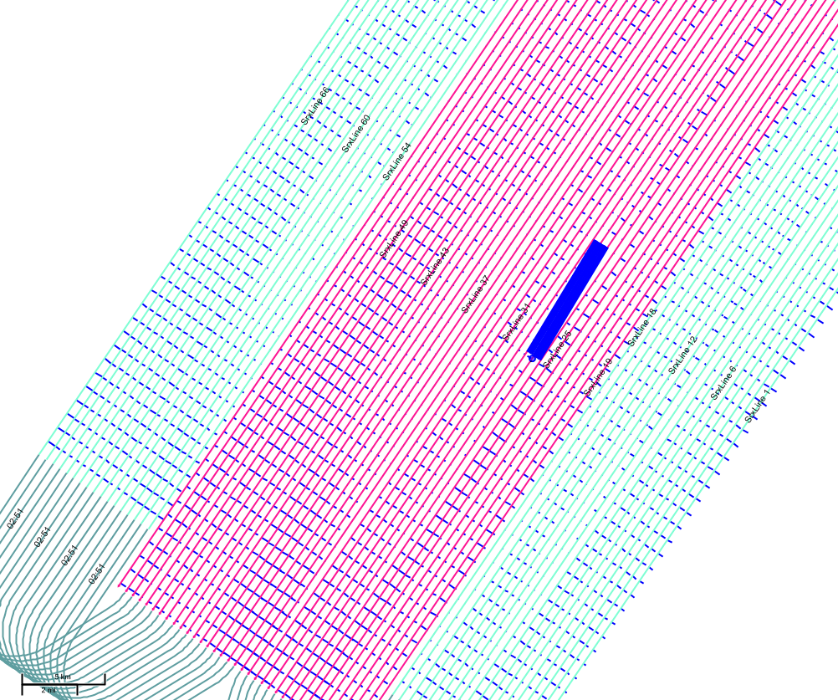
Current model applied to Survey Design Based on actual survey timing
Mismatched feathering on adjacent lines results in missing coverage
Infill lines required

Slide 11
Current model applied to Survey Design Based on actual survey timing
Mismatched feathering on adjacent lines results in missing coverage
Infill lines required

Slide 12
Current model applied to Survey Design Based on actual survey timing
Mismatched feathering on adjacent lines results in missing coverage
Infill lines required

Slide 13
3D Binning
Coverage specifications designed based on Fresnel zone/5D interpolation considerations.

Slide 14
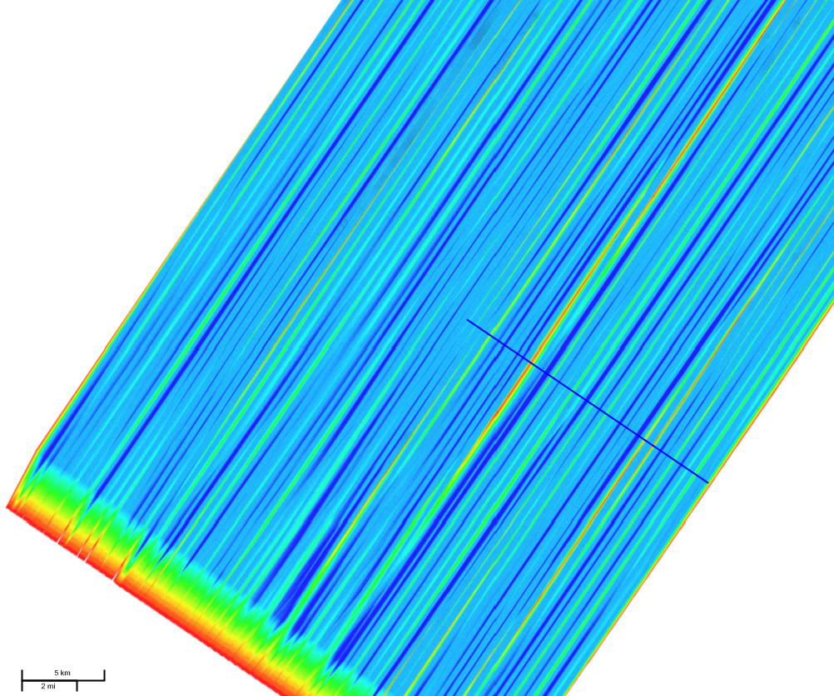
3D Binning
Coverage specifications designed based on Fresnel zone/5D interpolation considerations.
Offset
0 m
8000 m

Slide 15
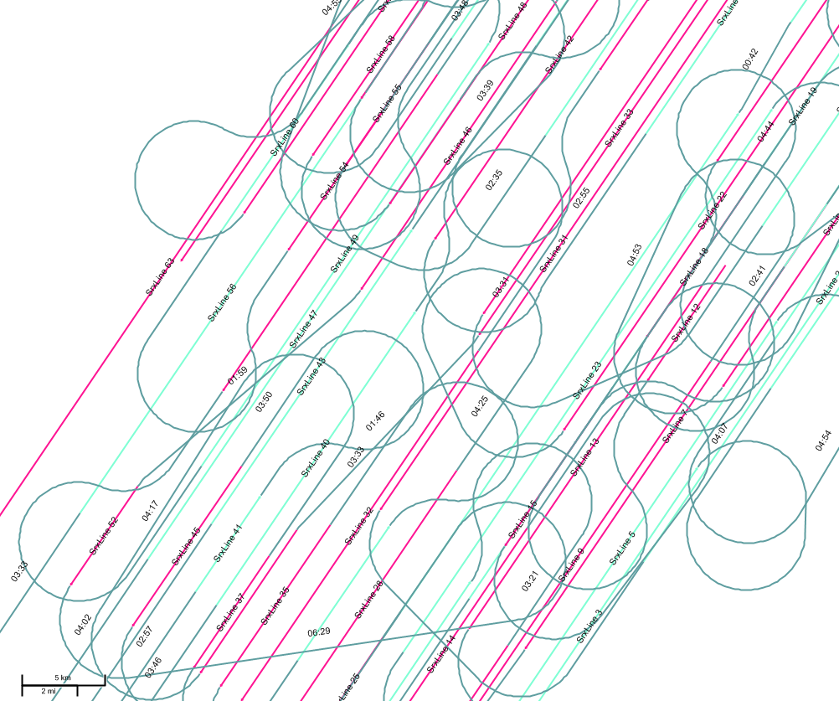
Infill estimated
52 Infill line segments required
Short, inefficient line segments
27% of primary line kms
1,009 kms
62% of primary acquisition time
18.9 days
Total Project Time : 71.1 days
2D + 3D + Infill
Excludes reconfiguration/mobilization

Slide 16
Presentation Outline
2D / 3D Project description and challenges
Estimating infill
Reducing infill
Final thoughts
Current Analysis
TSP
Generate Source & Receiver
Apply Downtime Model
Time and Motion
Create Survey (Towed Streamer)
Apply Currents
Infill Analysis
Export Infill Shape
Import Infill Plan
TSP (Infill)
Binning

Slide 17
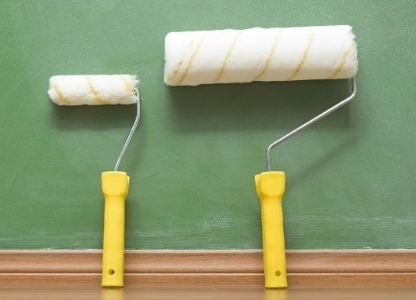
Impact of Number of streamers
Parallel streamers
6
10
14
5 sources
Conventional narrow towed
No streamer steering
6
10
14

Slide 18
Impact of Number of streamers
Parallel streamers
6
10
14
5 sources
Conventional narrow towed
No streamer steering
Assumptions
10% weather downtime
5% technical downtime
6
10
14
Streamers | Acquisition (Days) | Estimated Infill (Days/%) | TOTAL (Days)
6 | 50.7 | 23.9 / 47% | 74.6
10 | 30.3 | 18.9 / 62% | 49.2
14 | 21.7 | 12.9 / 59% | 34.6

Slide 19
Impact of Streamer Steering Strategy
Steered
Natural feather
Fanned
10 Streamer 5 sources | Estimated Infill (Days/%) | TOTAL (Days)
Streamer steering (2º) | 13.7 / 45% | 44.0
Natural feather | 18.9 / 62% | 49.2
Streamer fanning (2º) | 1.1 / 4% | 31.4
Parallel Fanned

Slide 20
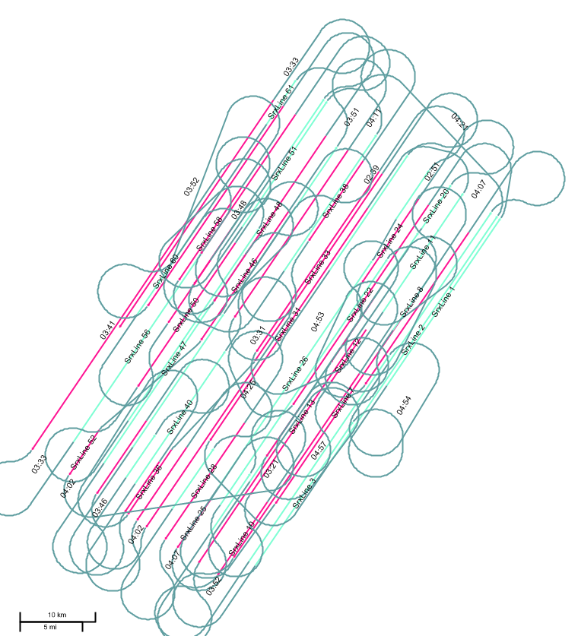
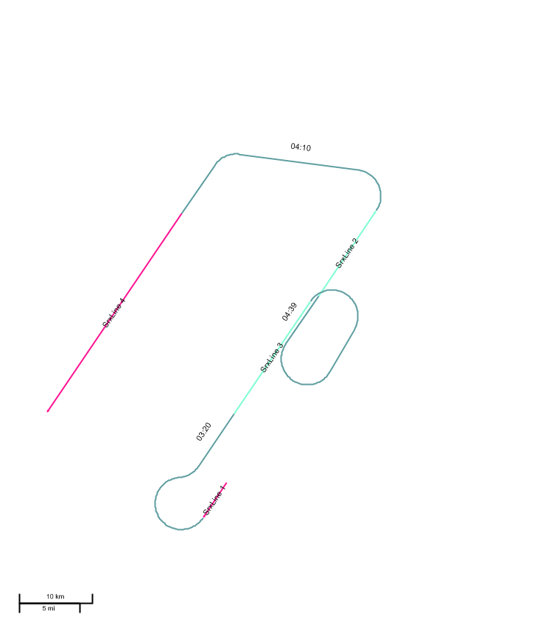
Impact of Streamer Steering Strategy
Infill plan
Natural feather
Infill plan
Fanned streamers (2º)

Slide 21
Marine Streamer Infill Optimization Summary
Integrated 2D and 3D program planning is critical to success in time limited projects
In-fill is a fact of life
… but it does not need to be a surprise !
Plan for it
Budget for it
Minimize it !
Other options to consider
Impact of in-line currents
Overlapping swaths(N+2 streamers, Roll N)
Vessel steering strategies
Feather matching strategies
Compressive sensing
Offset dependent bin size
Fresnel zone binning
Wide tow source

