Slide 1
Voice Activated Automation with FME
Liam Lyle

Slide 2
About Me:
Texas A&M University – College Station
Senior Geography Major – Class of 2021
Geography Society President
TAMU GeoInnovation Center Student Technician
Encana Intern – Summer 2019
Chevron Intern – Summer 2020

Slide 3
There is an estimated 3.25 billion voice assistant devices in use today. By 2023 – 8.0 billion
Source: Juniper Research, DIGITAL VOICE ASSISTANTS IN USE TO TRIPLE TO 8 BILLION BY 2023, DRIVEN BY SMART HOME DEVICES, 2018

Slide 4
Outline
What is Automated Voice Activated Data?
Examples
How To Voice Enable Your Data

Slide 5
What is Voice Activated Data?
Using speech recognition software “Voice Activated Data” assists in creating and displaying information without the use of manual/physical interaction with the data.

Slide 6
Why use voice?
Increase workplace efficiency by decreasing manual “hands-on” query times.

Slide 7
What does it look like?

Slide 8
Local Government Example:
“Hey Google … tell my server to build a heatmap of last week’s bike sharing bikes.”
Notes:
Liam

Slide 9
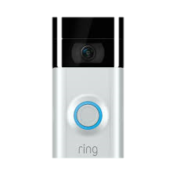
Police Force Example:
“Hey Google … tell my server to map out all past criminal activity in my current location and send my location to dispatch.”
“Hey Google … tell my server to stream video from Ring™Doorbells along Elm Street to me.”
Notes:
Liam

Slide 10
Oil and Gas Example
“Hey Google … tell my server to display all seismic events that happened in *STATE* near one of our wells between the years *YEAR* and *YEAR* with a magnitude higher than *MAGNITUDE*.”
Notes:
Liam

Slide 11
USGS Water Data
Give me a Texas County …
“Show river statistics in *COUNTY NAME*”
Notes:
Show River Statistics in … *County name*

Slide 12
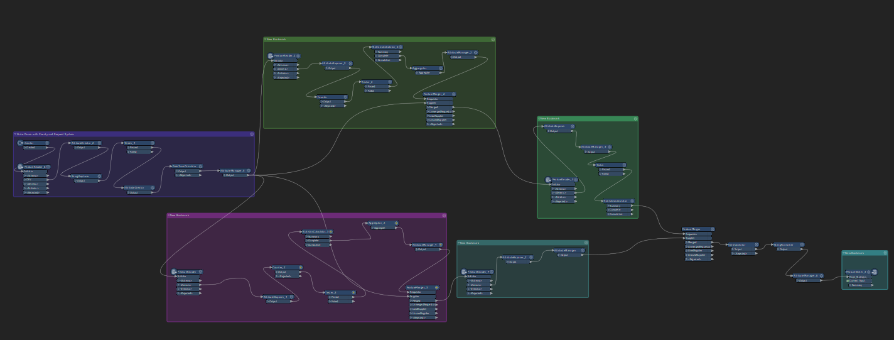
FME Workbench – Simple process
Notes:
Liam

Slide 13
How am I doing it?
Google Home
Push2Run
.bat File
IfThisThenThat
PushBullet
FME Workbench

Slide 14
Give your data a voice.

